Slide 1
Literature Review
Md. Mojibur Rahman
mrahmanelt@iitism.ac.in

Slide 2
What is a Literature Review?
A literature review is simply a summary of what existing scholarship knows about a particular topic. It is always based on secondary sources – that is, what other people have already written on the subject; it is not concerned about discovering new knowledge or information. As such, it is a prelude to further research, a digest of scholarly opinion.
A literature review should focus only on the relevant academic literature: popular or non-academic sources may be brought in occasionally to illustrate a point, but the central interest is always on the data collected or the theories put together by recognised experts in the field.
A literature review will try to look at as much of this existing research as possible. It will review major scholarly books in the relevant area, but will also take a keen interest in journal articles, which in many subjects give more up-to-date material.

Slide 3
A literature review selects relevant past literature and CONNECTS, SYNTHESIZES, and sometimes EVALUATES these texts/studies, putting the authors in conversation with each other.
A literature review is a survey of everything that has been written about a particular topic, theory, or research question. It may provide the background for larger work, or it may stand on its own.
Much more than a simple list of sources, an effective literature review analyzes and synthesizes information about key themes or issues.

Slide 4
Book Review | Annotated Bibliography | Literature Review
Analyzes and evaluates a particular book. | Summarizes relevant sources and explains the significance of that source to the research question. | Surveys all relevant literature to determine what is known and not known about a particular topic.
Why write a literature review?
To discover what has been written about a topic already
To determine what each source contributes to the topic
To understand the relationship between the various contributions, identify and (if possible) resolve contradictions, and determine gaps or unanswered questions

Slide 5
Types of Literature Review
Narrative literature review
Systematic literature review
Scoping literature review
Argumentative literature review
Integrative literature review
Theoretical literature review
Methodological literature review
Historical literature review

Slide 6
Narrative Literature Review
Narrative literature review, also referred to as traditional literature review, critiques literature and summarizes the body of a literature.
Narrative review also draws conclusions about the topic and identifies gaps or inconsistencies in a body of knowledge.
You need to have a sufficiently focused research question to conduct a narrative literature review

Slide 7
Systematic Literature Review
Systematic literature review requires more rigorous and well-defined approach compared to most other types of literature review.
Systematic literature review is comprehensive and details the timeframe within which the literature was selected.
Systematic literature review can be divided into two categories: meta-analysis and meta-synthesis.
When you conduct meta-analysis you take findings from several studies on the same subject and analyze these using standardized statistical procedures.

Slide 8
In meta-analysis patterns and relationships are detected and conclusions are drawn. Meta-analysis is associated with deductive research approach.
Meta-synthesis, on the other hand, is based on non-statistical techniques.
This technique integrates, evaluates and interprets findings of multiple qualitative research studies.
Meta-synthesis literature review is conducted usually when following inductive research approach.

Slide 9
Scoping Literature Review
Scoping literature review, as implied by its name is used to identify the scope or coverage of a body of literature on a given topic.
It has been noted that “scoping reviews are useful for examining emerging evidence when it is still unclear what other, more specific questions can be posed and valuably addressed by a more precise systematic review.”
The main difference between systematic and scoping types of literature review is that, systematic literature review is conducted to find answer to more specific research questions, whereas scoping literature review is conducted to explore more general research question.

Slide 10
Argumentative Literature Review
Argumentative literature review, as the name implies, examines literature selectively in order to support or refute an argument, deeply imbedded assumption, or philosophical problem already established in the literature.
The purpose is to develop a body of literature that establishes a contrarian viewpoint. Given the value-laden nature of some social science research [e.g., educational reform; immigration control], argumentative approaches to analyzing the literature can be a legitimate and important form of discourse.
It should be noted that a potential for bias is a major shortcoming associated with argumentative literature review.

Slide 11
Integrative Literature Review
Integrative literature review reviews, critiques, and synthesizes secondary data about research topic in an integrated way such that new frameworks and perspectives on the topic are generated.
If your research does not involve primary data collection and data analysis, then using integrative literature review will be your only option.
The body of literature includes all studies that address related or identical hypotheses.
A well-done integrative review meets the same standards as primary research in regard to clarity, rigor, and replication.

Slide 12
Theoretical Literature Review
Theoretical literature review focuses on a pool of theory that has accumulated in regard to an issue, concept, theory, phenomena.
Theoretical literature reviews play an instrumental role in establishing what theories already exist, the relationships between them, to what degree existing theories have been investigated, and to develop new hypotheses to be tested.
At the earlier parts of the literature review chapter, you need to specify the type of your literature review your chose and justify your choice.
Your choice of a specific type of literature review should be based upon your research area, research problem and research methods.
Also, you can briefly discuss other most popular types of literature review mentioned above, to illustrate your awareness of them.

Slide 13
Methodological Literature Review
A review does not always focus on what someone said [content], but how they said it [method of analysis].
This approach provides a framework of understanding at different levels (i.e. those of theory, substantive fields, research approaches, and data collection and analysis techniques), enables researchers to draw on a wide variety of knowledge ranging from the conceptual level to practical documents for use in fieldwork in the areas of ontological and epistemological consideration, quantitative and qualitative integration, sampling, interviewing, data collection and data analysis, and helps highlight many ethical issues which we should be aware of and consider as we go through our study.

Slide 14
Historical Literature Review
Few things rest in isolation from historical precedent.
Historical reviews are focused on examining research throughout a period of time, often starting with the first time an issue, concept, theory, phenomenon emerged in the literature, then tracing its evolution within the scholarship of a discipline.
The purpose is to place research in a historical context to show familiarity with state-of-the-art developments and to identify the likely directions for future research.

Slide 15
Three Types of Literature Review Organization
Organization Type | Explanation | Usage
Chronological | Organized by publication date or history of topic | Use this type if sequential order of events is important
Thematic | Organized by topic or issue, may still involve chronology or an order of importance | Use this type to go from general topic themes to more specific (e.g., education to higher education to writing centers)
Methodological | Organized not by the content of lit review material, but on the methods of the researcher/writer | Use this type if the methods of the researchers/writers are the most important

Slide 16
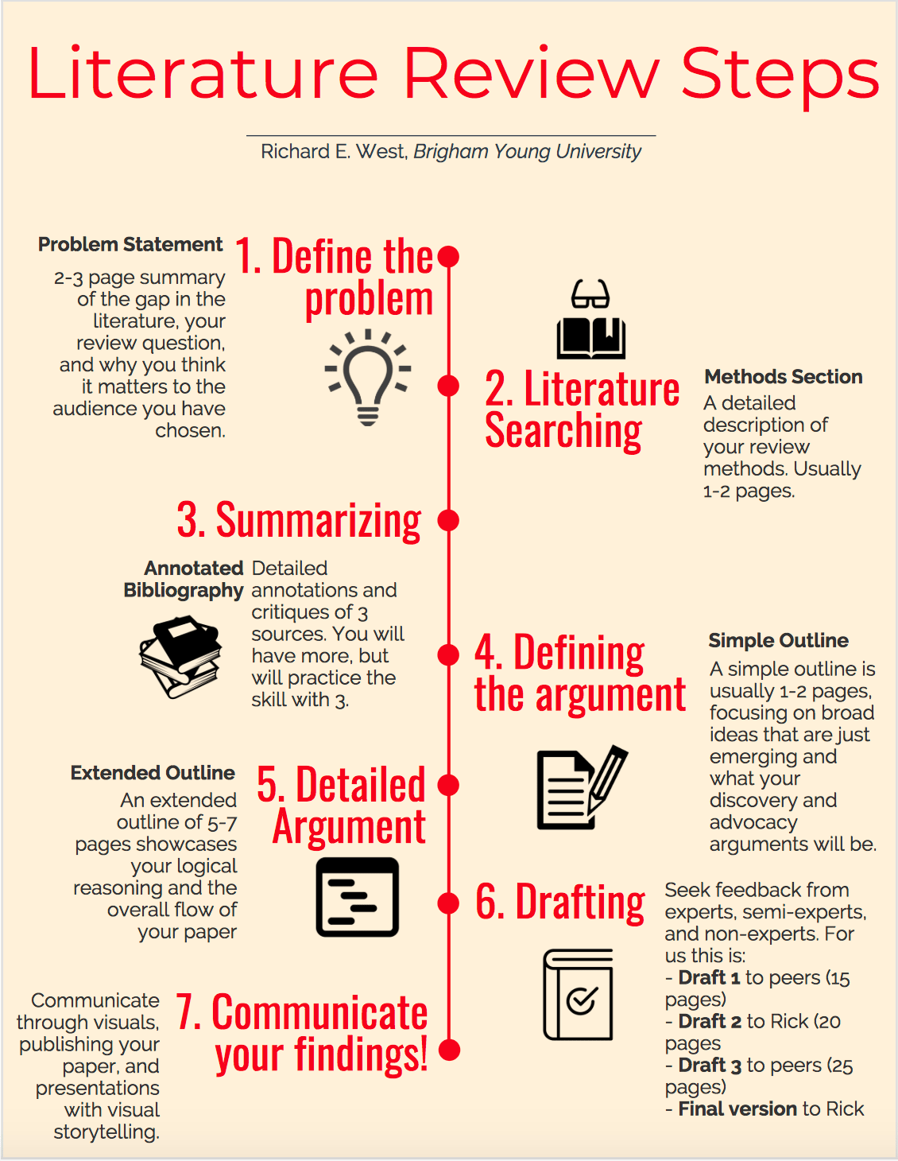

Slide 17
THANK YOU

